Slide 1



Calibrating the ATLAS Calorimeter using Single Particle Interactions with Machine Learning
David Polk, Kenneth Johns, Peter Loch, Jad Sardain

Slide 2
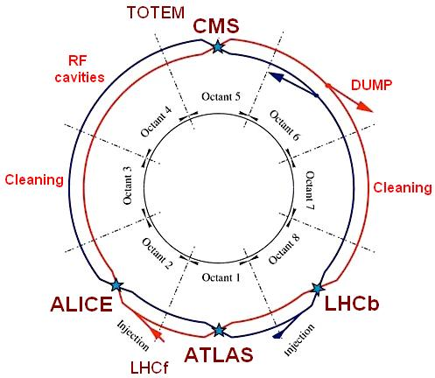
Large Hadron Collider
The LHC collides high energy protons together at speeds close to the speed of light.
Studies matter and energy at a fundamental level
The beams intersect at four points around the ring.
2
Notes:
The ATLAS and CMS experiments discovered the Higgs boson, which is strong evidence that the Standard Model has the correct mechanism of giving mass to elementary particles
The collider tunnel contains two adjacent parallel beamlines (or beam pipes) each containing a beam, which travel in opposite directions around the ring.
Reproduces the conditions that existed within a billionth of a second after the Big Bang.
Located at the collision sites are large detectors that look for different events.

Slide 3
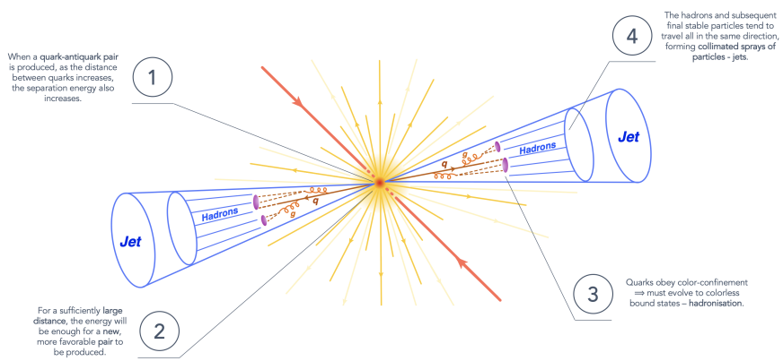
Jets vs Single Particles
Proton-Proton collisions produce
  Hadronic showers caused by a chain reaction of decaying hadronic particle. Commonly known called “jets”.
  An array of single, or individual particles
Single Particles
Proton
Proton

Slide 4
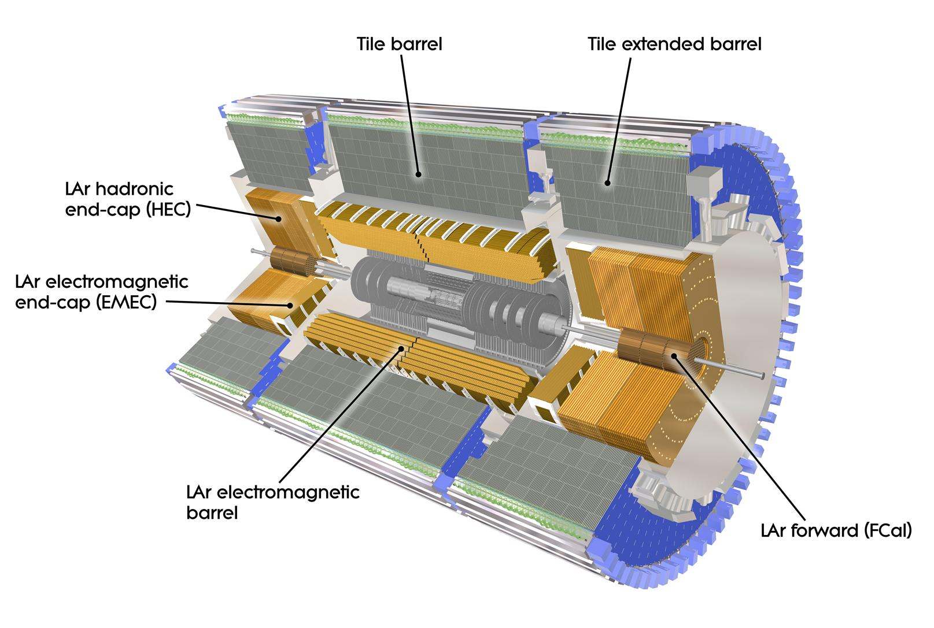
ATLAS Calorimeter
Barrel around collision point
Reads electromagnetic energy deposited by particles
Collision point
Calorimeter Barrel

Slide 5
Motivation
Use Deep Neural Networks to calibrate for more accurate energy readings of topological clusters.
  The input features were taken from topological clusters associated with jets.
  This was documented in ATLAS Public Note ATL-PHYS-PUB-2023-019
For completeness, we studied whether input features taken from topological clusters associated with single particles gave similarly good performance.

Slide 6
Methodology
Single Particle
  w/ Pileup - SPP
  No Pileup – SPNP
Pileup: Multiple events occur/are detected at the same time
Jet-Jet was done in pubnote (ATL-PHYS-PUB-2023-019)
Trained on:
Jet
SPP
SPNP
Tested on:
Jet
SPP
SPNP
Trained on | Tested on | Nomenclature
Jet | Jet | Jet-Jet
Jet | SPP | Jet-SPP
SPP | Jet | SPP-Jet
SPNP | SPP | SPNP-SPP

Slide 7
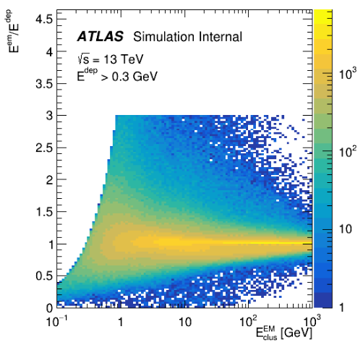


2D Linearity vs Cluster Energy
Target:
Response at EM scale
/
Response at 1 means prediction was perfect
This plot allows us to see how well our DNN performed at different energies
Plot is hard to quantify
Notes:
Define edep and eem

Slide 8
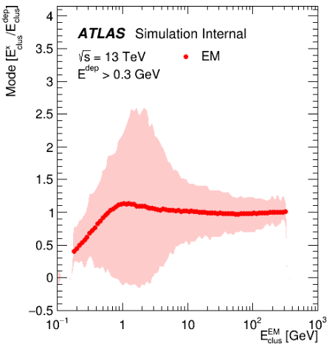
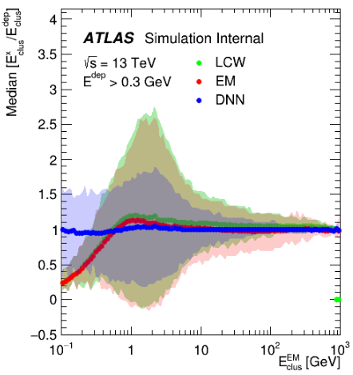
Median
%68 IQR
%68 IQR

Slide 9
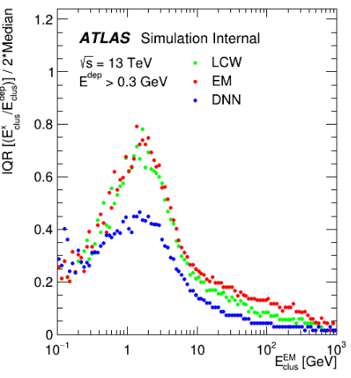
Jet - Jet
We were able to replicate results similar to PubNote:
DNN performs better than current calibration method (LCW)

Slide 10
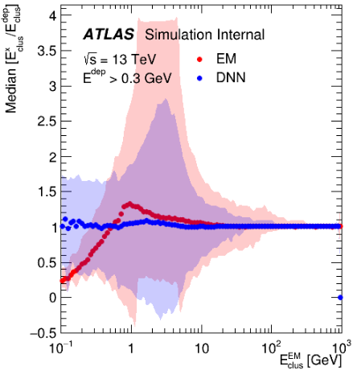
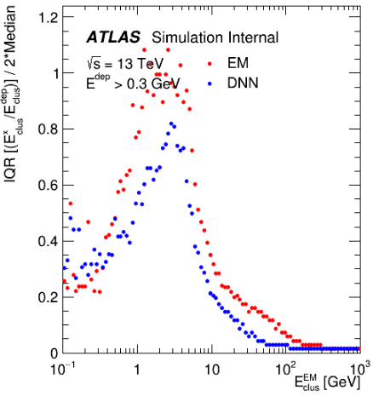
SPP - SPP
DNN also performs well when applied to Single Particles with Pileup

Slide 11
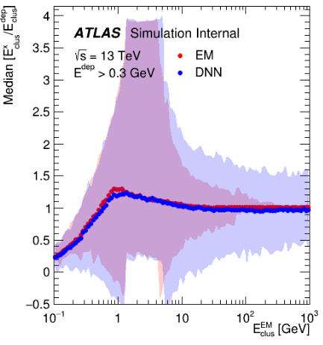
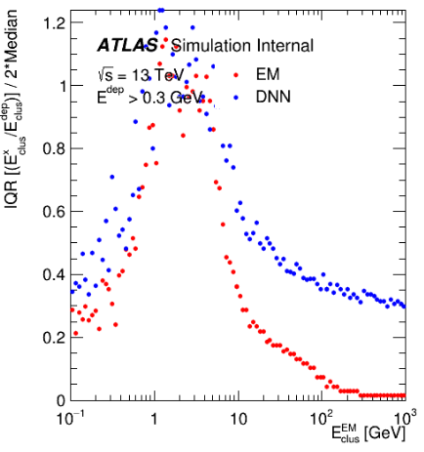

Jet - SPP
Linearity does not improve
Matches scale
Relative Resolution degrades
Performs worse than

Slide 12
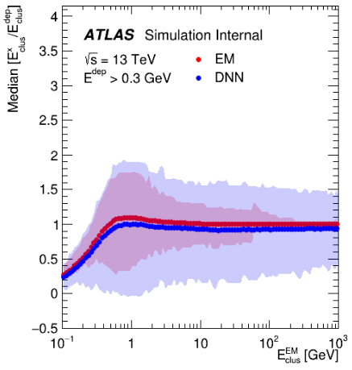
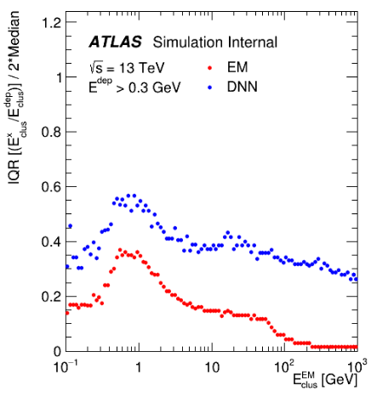
SPP - Jet
Linearity does not improve significantly
Relative Resolution degrades with this setup

Slide 13
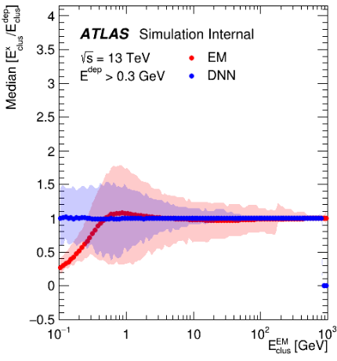
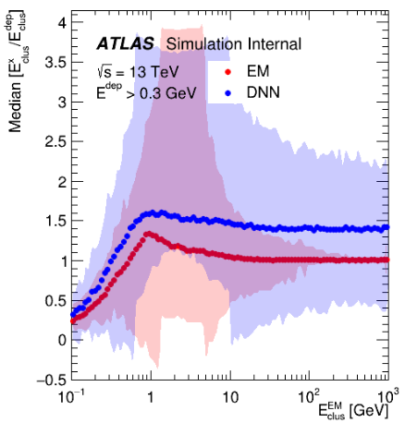
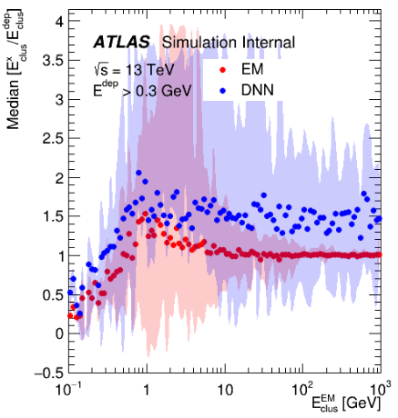
DNN Trained with: Single Particle with No Pileup
SPNP - SPNP
SPNP - SPP
SPNP - Jet
Notes:
Have red points match blue points

Slide 14
Concluding Thoughts
Using consistent data for training and testing generally produces the best results
  e.g. training and testing with jet data produces better results than training with jet data and testing with single particle data.
Following the approach of deriving calibrations from single particles with or without pileup leads to degradations of Linearity and Resolution when using a DNN trained with jet data, and vice versa.

Slide 15

Acknowledgements
NASA Space Grant Program
US ATLAS
Kenneth Johns
Peter Loch
Jad Sardain
Michelle Coe
Chandra Holifield
Yancy Shirley
Nicolas Mazziotti
Walter Rahmer
Hanga Andras

Slide 16
Thank you

Slide 17
Appendix

Slide 18
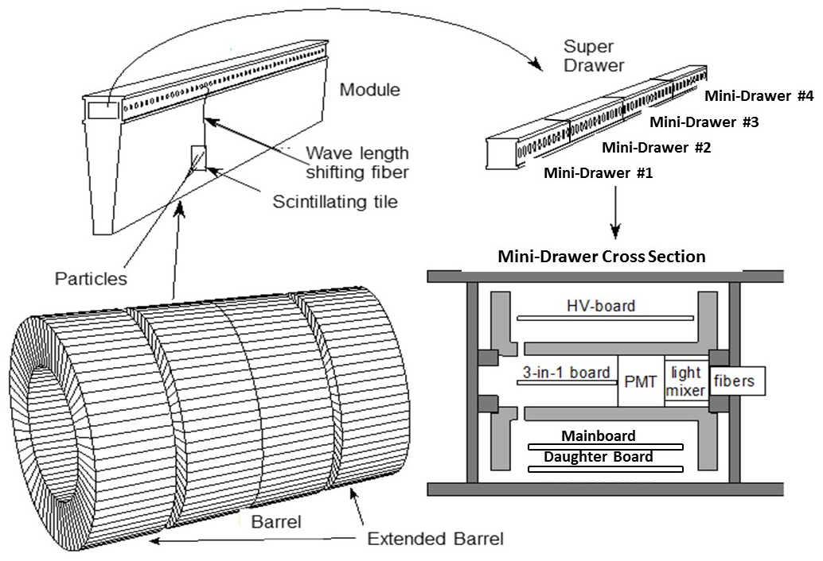
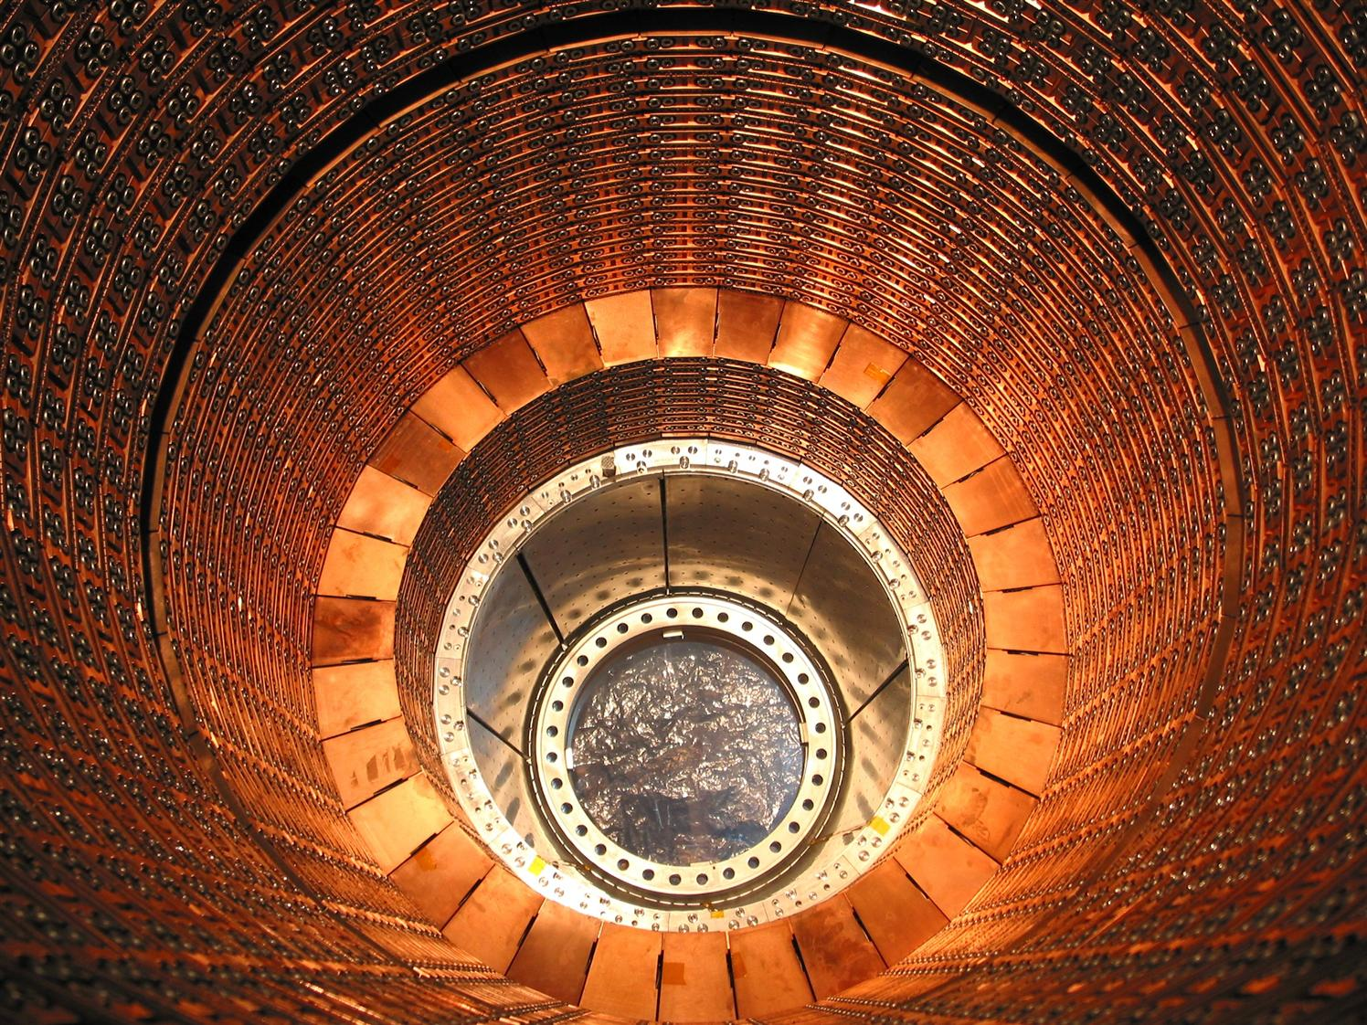
Calorimeter
Collision point
Calorimeter Barrel

Slide 19
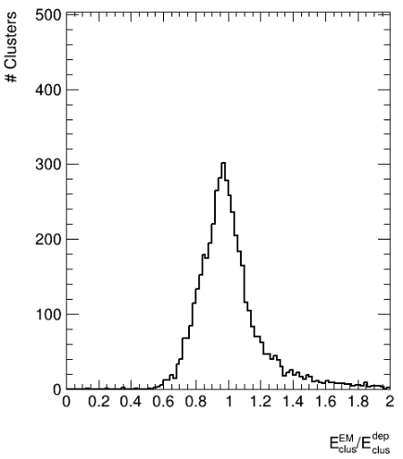
Methodology: Projection Y

Slide 20
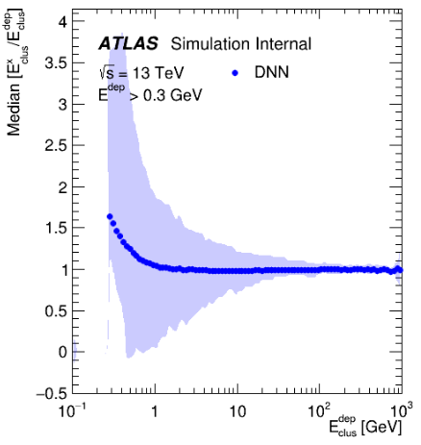
Analysis Method
Median
0.994
Median
0.994
68% IQR
*Smallest quantile range that holds 68% of data
68% IQR*

Slide 21
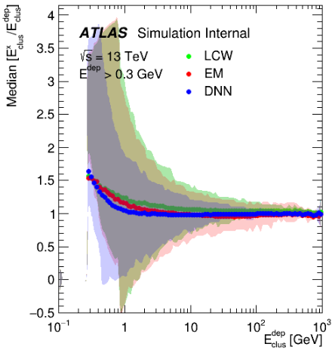

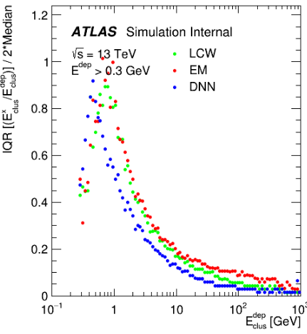
Jet-Jet
Able to replicate results similar to PubNote:
DNN performs better than

Slide 22
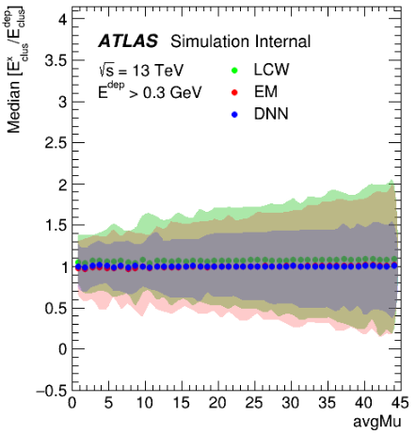
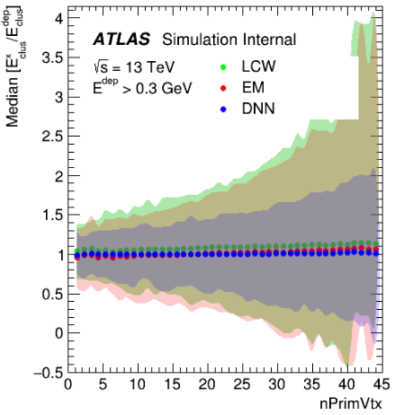
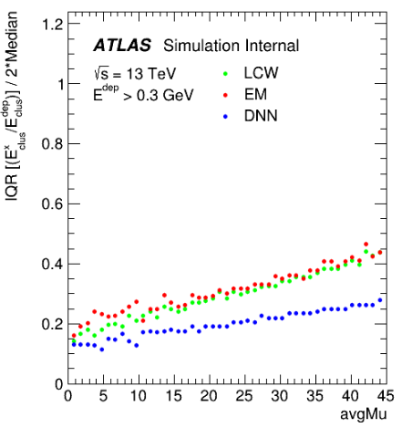
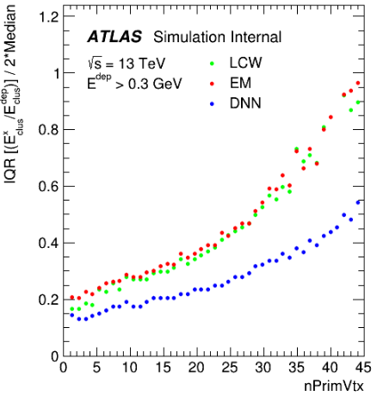
Jet-Jet

Slide 23
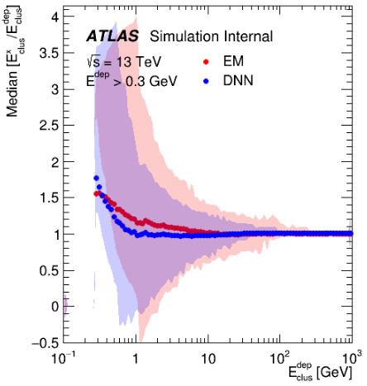
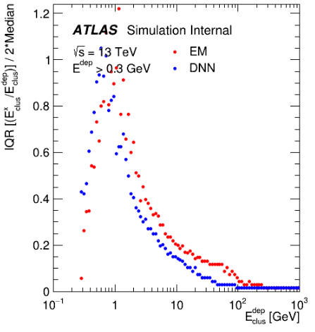
SPP - SPP
DNN also performs well when applied to Single Particles with Pileup

Slide 24
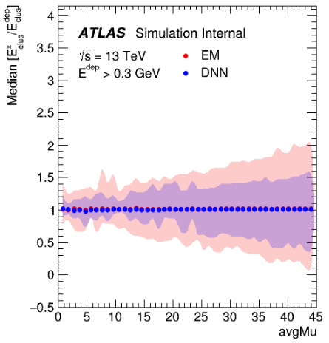
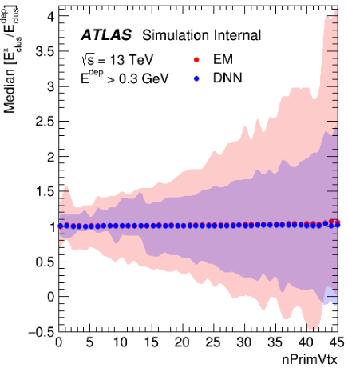
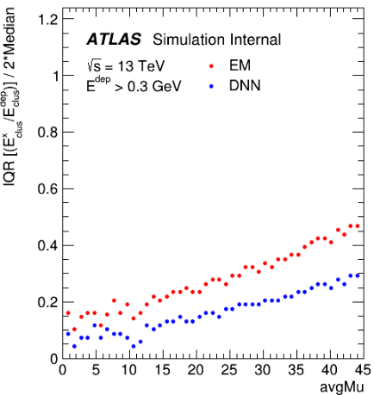
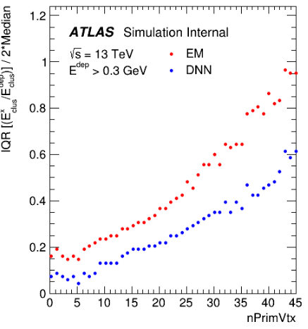
SPP - SPP

Slide 25
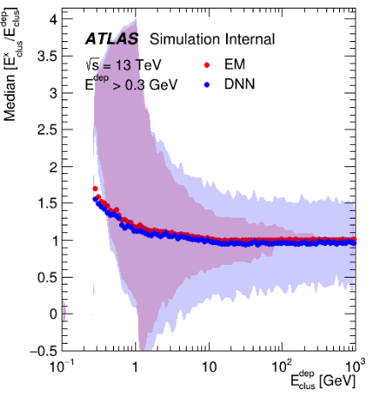
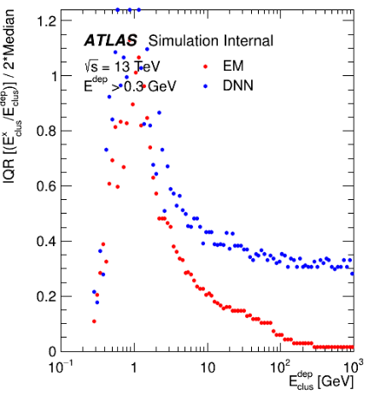
Jet - SPP
Linearity does not improve
Matches scale
Relative Resolution degrades
Performs worse than

Slide 26
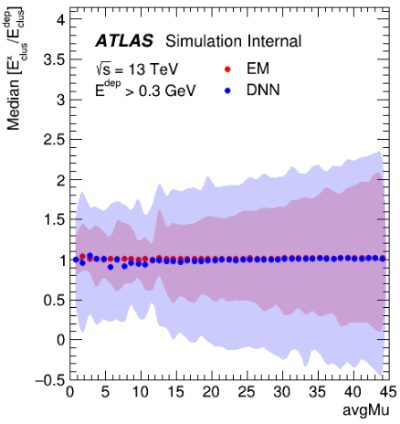
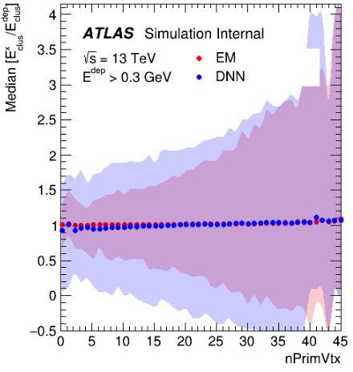
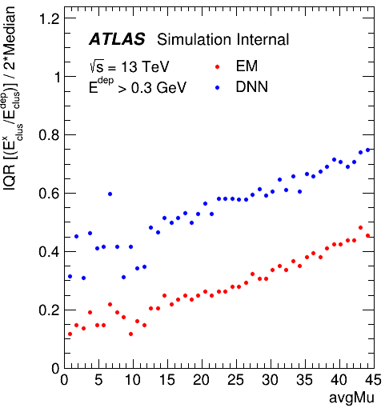
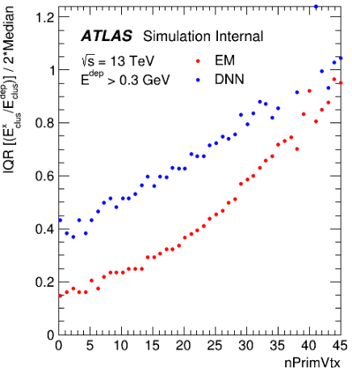
Jet - SPP

Slide 27
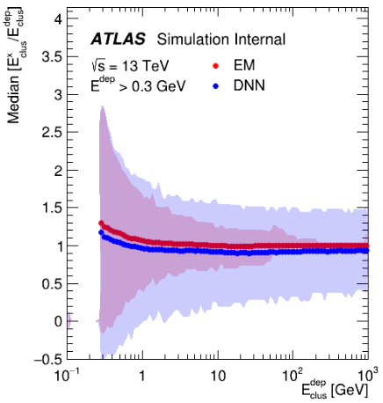
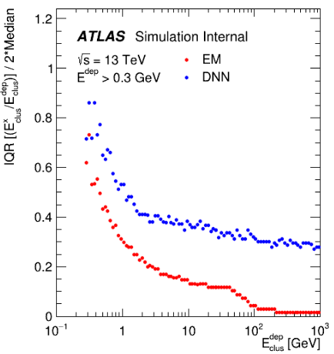
SPP - Jet
Linearity does not improve significantly
Relative Resolution degrades with this setup

Slide 28
Single Particle with No Pileup
SPNP - SPNP
SPNP - SPP
SPNP - Jet

Slide 29
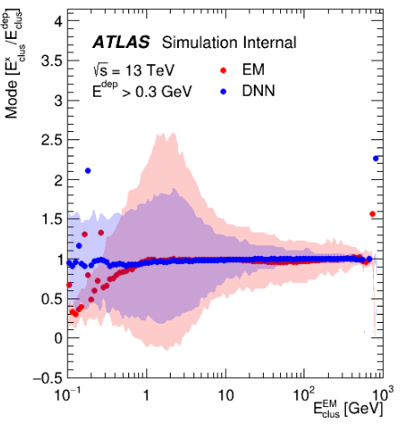
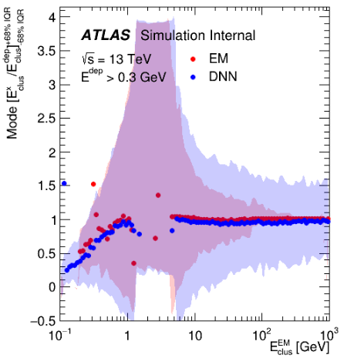
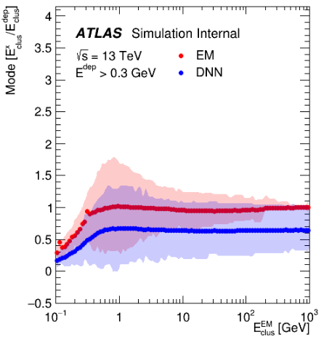
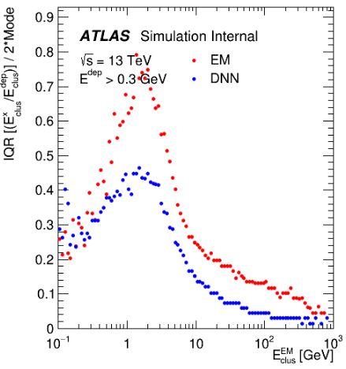
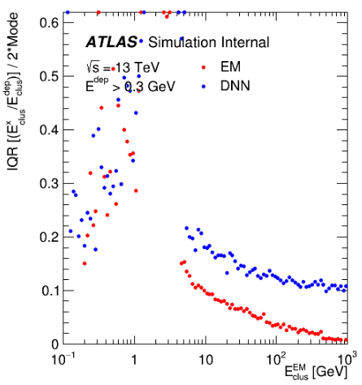
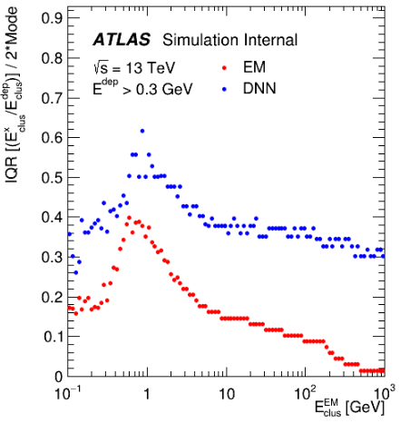
Jets
Jet-Jet
Jet-SPP
Jet-SPNP

Slide 30
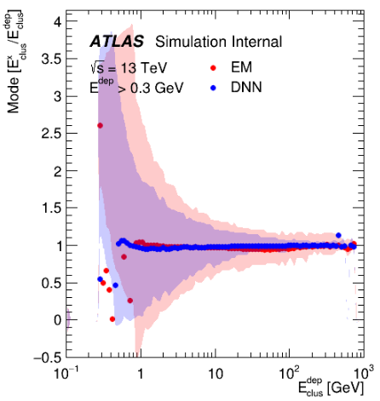
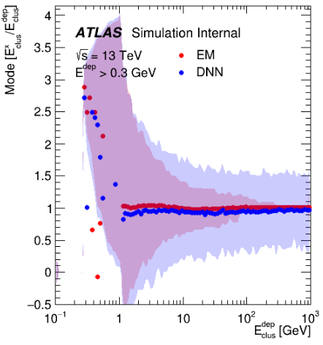
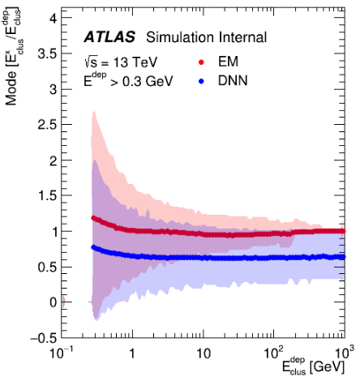
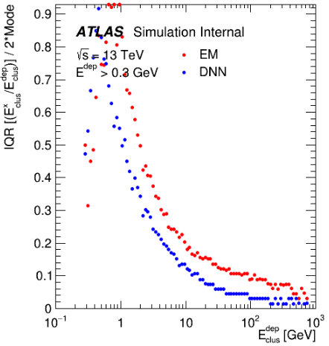


Jets
Jet-Jet
Jet-SPP
Jet-SPNP

Slide 31






Single Particle with Pileup
SPP - SPP
SPP - SPNP
SPP - Jet
Notes:
Look at EM scale results

Slide 32






Single Particle with Pileup
SPP - SPP
SPP - SPNP
SPP - Jet
Notes:
Look at EM scale results

Slide 33






Single Particle with No Pileup
SPNP - SPNP
SPNP - SPP
SPNP - Jet
Notes:
Look at EM scale results

